Slide 1
Microprocessor and Computer Architecture(ELX 301)
BIT 3rd Semester
Er. Suraj Basant Tulachan
Assistant Professor

Slide 2
Unit 9: Pipelining
Outline:
  5.1 Pipelining.
  5.2 Arithmetic Pipeline.
  5.3 Instruction Pipeline.
  5.4 Pipeline Hazards

Slide 3
Unit 9: Pipelining
Pipelining:-
Pipelining is a technique of decomposing/dividing a sequential process into sub
operations.
Each sub process are executed in a special dedicated segment that operates
concurrently with all other segments.
Each segment performs partial processing dictated by the way the task partitioned.
The result obtained from the computation in each segment is transferred to the
next segment in the pipeline.

Slide 4
Unit 9: Pipelining
Pipelining:-
The final result is obtained after the data have passed through all segments.
It is characteristic of pipelines that several computations can be in progress in
distinct segments at the same time.
The registers provide isolation between each segment so that each can operate on
distinct data simultaneously.

Slide 5
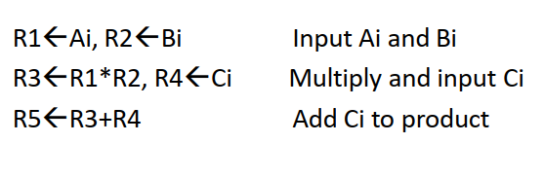
Unit 9: Pipelining
Suppose we want to perform the combined multiply and add operations with a
stream of numbers.
E.g. Ai * Bi + Ci for i = 1 , 2, 3,…….,7
The sub operations performed in each segment of the pipeline
are as follows:

Slide 6
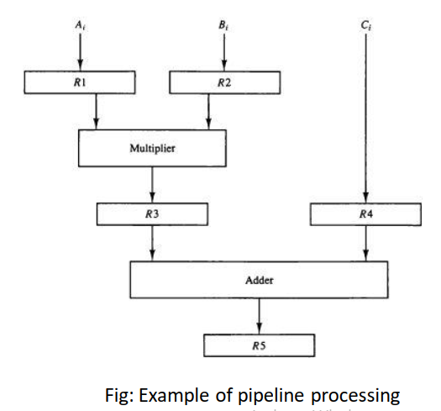
Unit 9: Pipelining

Slide 7
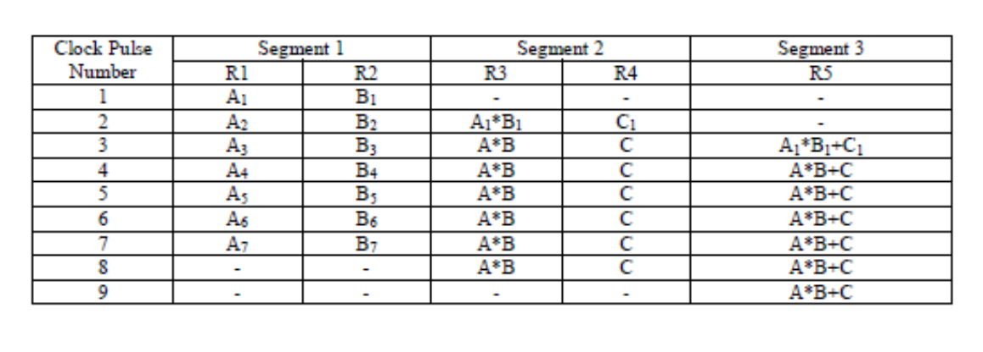
Unit 9: Pipelining

Slide 8
Unit 9: Pipelining
Speedup Equation
Consider a K-segment pipeline with a clock cycle time tp to execute n tasks.
The first task T1 require time Kt_{p} to complete.
The remaining (n-1) tasks finish at the rate of one task per click cycle and will be
completed after time (n-1) t_{p}.
The total time to complete the n task is [Kt_{p}+ (n - 1) t_{p}] = (K + n - 1) t_{p}.
Consider a non–pipeline unit that performs the same operation and takes t_{n} time to
complete each task.
The total time required for n tasks would be nt_{n}.

Slide 9
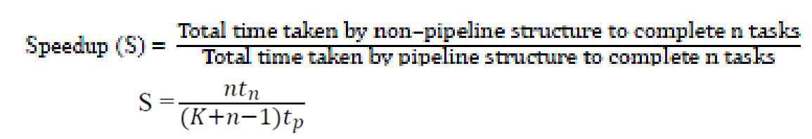
Unit 9: Pipelining
The speedup of pipeline processing over an equivalent
non–pipeline processing is defined by the ratio

Slide 10
Unit 9: Pipelining
Speedup Equation:-
As number of tasks increases, n becomes much larger than K - 1, and (K + n – 1)
approaches to n then
S=t_{n} / t_{p}
If we assume that the time to process a task is same in both circuits then t_{n} = Kt_{p}
S=k t_{p}/t_{p}= K

Slide 11
Unit 9: Pipelining
Calculate pipeline speedup if time taken to complete a task in conventional
machine is 25 ns. In the pipeline machine, one task is divided into 5 segments and
each sub operation tasks take 4 ns. Number of tasks to be completed is 100.
Solution: Here,
Time taken to complete a task (t_{n}) = 25 ns
Number of segment (K) = 5
Clock cycle time (t_{p}) = 4 ns
No. of tasks (n) = 100
S=nt_{n} / (K+n-1)t_{p}

Slide 12
Unit 9: Pipelining
Q. A non–pipeline system takes 100 ns to process a task. The same task can be processed in a six-segment pipeline with time delay of each segment in the
pipeline is as follows; 20 ns, 25 ns, 30 ns. Determine the speed of ratio of
pipeline for 100 tasks.
Solution:
t_{n} = 100 ns
K = 6
t_{p} = 30 ns
n = 100
S= nt_{n} / (K+n-1) t_{p}

Slide 13
Unit 9: Pipelining
Q. Suppose that time delays of four segments are t1 =60ns, t2 = 70 ns, t3 = 100 ns, t4 = 80 ns and interface register have a delay of 10 ns. Determine the speed up ratio.
Solution:
Here,
t_{p} = 100 + 10 = 110 ns
t_{n} = t1 + t2 + t3 + t4=60+70+100+80 = 320 ns
S=t_{n} / t_{p}

Slide 14
Unit 9: Pipelining
Arithmetic Pipelining:-
Arithmetic Pipelining is used in very high speed computers.
They are used to implement floating point operations, multiplication of fixed point
numbers.
Various Computations in scientific problems.
Example of a pipeline unit for floating point addition and subtraction is shwon in next slide.

Slide 15
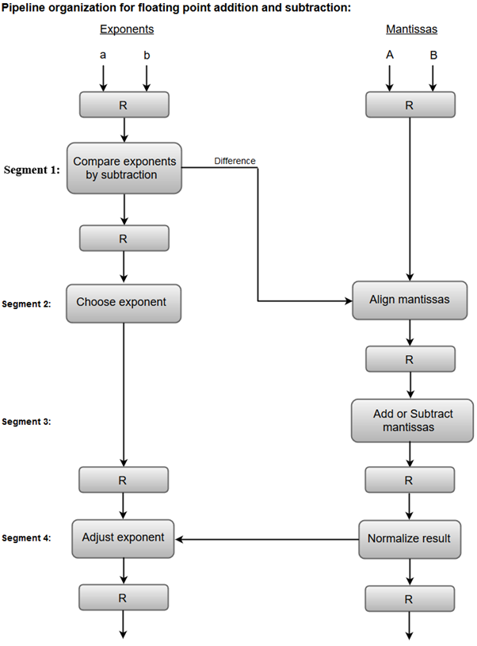
Unit 9: Pipelining

Slide 16
Unit 9: Pipelining
Arithmetic Pipelining:-
The inputs to the floating point adder pipeline are two normalized floating point binary numbers.
X=A x 2^a
Y=B x 2^b
The floating point addition and subtraction can be performed in four segments, as shown in figure.
The registers labeled R are placed between the segments to store intermediate results.

Slide 17
Unit 9: Pipelining
Arithmetic Pipelining:-
The sub operations that are performed in the four segments are:
i) Compare the exponents.
ii) Align the mantissas.
iii) Add or subtract the mantissas.
iv) Normalize the result
Procedure:
The exponents are compared by subtracting them to determine their
difference.
The larger exponent is chosen as the exponent of the result.
The exponent difference determines how many times the mantissa
associated with the smaller exponent must be shifted to the right.
This produces an alignment of the two mantissas.

Slide 18
Unit 9: Pipelining
Arithmetic Pipelining:-
It should be noted that the shift must be designed as a combinational circuit to reduce the shift time.
The two mantissas are added or subtracted in segment 3.
The result is normalized in segment 4.
When an overflow occurs, the mantissa of the sum or difference is shifted right and the exponent incremented by one.
If an underflow occurs, the number of leading zeros in the mantissa determines the number of left shifts in the mantissa and the number that must be subtracted from the exponent.

Slide 19
Unit 9: Pipelining
Arithmetic Pipelining:-
For simplicity, we use decimal numbers, the two normalized floating-point
numbers:
X = 0.9504 x 10^3
Y = 0.8200 x 10^2
The two exponents are subtracted in the first segment to obtain 3-2 = 1.
The larger exponent 3 is chosen as the exponent of the result.

Slide 20
Unit 9: Pipelining
Arithmetic Pipelining:-
The next segment shifts the mantissa of Y to the right to obtain
X = 0.9504 x 10^3
Y = 0.0820 x 10^3
This aligns the two mantissas under the same exponent.
The addition of the two mantissas in segment 3 produces the sum
Z = 1.0324 x 10^3

Slide 21
Unit 9: Pipelining
Instruction Pipelining:-
Pipeline processing can occur in the data stream and instruction stream
as well.
This technique is called Instruction Pipelining.
An Instruction pipeline reads consecutive instructions from memory
while previous instructions are being executed in other segments.

Slide 22
Unit 9: Pipelining
Instruction Pipelining:-
This causes the instruction fetch and execute phases to overlap and
perform simultaneous operations.
Instruction processing is divided into two sub operations:
Fetch instruction.
Execute instruction

Slide 23
Unit 9: Pipelining
Instruction Pipelining:-
During execution, there is time when main memory is not being accessed.
During this time, the next instruction could be fetched and buffered (called instruction pre-fetch or fetch overlap).
In the most general case, the computer needs to process each instruction with the following sequence of steps:
i. Fetch the instruction from memory.
ii. Decode the instruction.
iii. Calculate the effective address.
iv. Fetch the operands from memory.
v. Execute the instruction.
vi. Store the result in the proper place.

Slide 24
Unit 9: Pipelining
Instruction Pipelining:-
To again further speed up, the pipeline must have more stages consider the following decomposition of instruction processing.
a) Fetch instruction (FI)
b) Decode instruction (DI)
c) Fetch operands (FO)
d) Execute instruction (EI)

Slide 25
Unit 9: Pipelining
Pipeline Hazards:-
Resource conflicts
If one common memory is used for both data and instruction, and there is need to read/write data and fetch the instruction at the same time, the resource conflicts occur.
Data dependency conflict
Data dependency conflicts arise when an instruction depends on the result of a previous instruction but result of that instruction is not yet available.
Branch difficulties
Branch difficulties arise from program control instructions that may change the value of PC.
A program is not a straight flow of sequential instructions.
There may be branch instructions after the normal flow of program which
delay the pipelining executions and affects the programs

Slide 26
Unit 9: Pipelining
Solution of pipeline hazards
1. Resource conflicts can be solved by using separate instruction and
data memory.
2. Solution of data dependency conflict
we have following methods:
i) Hardware Interlock
Hardware interlock is a circuit that is responsible to detect the data
dependency.
After detecting the particular instruction needs data from
instruction which is being executed, hardware interface delays the instruction till the data is not available

Slide 27
Unit 9: Pipelining
Solution of Pipeline hazards(Data Conflict)
ii. Operand Forwarding
Operand forwarding uses special hardware to detect a conflict and then
avoid by routing the data through special paths between pipeline segments.
iii. Delayed Load
Delayed load is a procedure that gives the responsibilities for solving
data conflicts to the compiler.
The compiler is designed to detect conflict & reorder the instructions as necessary to delay the loading of the conflicting data by inserting no operation instructions.

Slide 28
Unit 9: Pipelining
Solution of Pipeline hazards(Branch Difficulties)
1. Pre fetch target instruction
Both the branch target instruction & the instruction following the branch are pre fetched and are saved until the branch instruction is executed.
If branching occurs then branch target instruction is continuous.
2. Branch Target buffer (BTB)
A branch target buffer is an associative memory included in fetch segment of branch instruction that stores the target situation for the previously executed branch.
It also stores the next few instructions after the branch target instruction.
This way, the branch instructions that have occurred previously are readily available in the pipeline without interruption.

Slide 29
Unit 9: Pipelining
Solution of Pipeline hazards(Branch Difficulties)
3. Loop buffer
The loop buffer is similar to BTB but its speed is high.
Program loops are stored in the loop buffer.
The program loop then can be executed directly without having access to memory.
4. Branch prediction
Special hardware is used to detect the branch in the conditional branch instruction.
On the basis of prediction, the instructions are pre fetched.
5. Delayed branch
Compiler detects the branch instructions, so it re-arranges the instruction to make delay by inserting no operation instruction.

Slide 30
THANK YOU

